Slide 1

Multiple Linear Regression
Aksadur Rahman
aksadur@yahoo.com

Slide 2
Multiple Linear Regression
Simple Linear Regression:
Simple linear regression is a regression model that estimates the relationship between one independent variable and one dependent variable using a straight line. Both variables should be quantitative.
The example data in Table
X (Independent Variable) | Y (Dependent Variable)
1.00 | 1.00
2.00 | 2.00
3.00 | 1.30
4.00 | 3.75
5.00 | 2.25

Slide 3
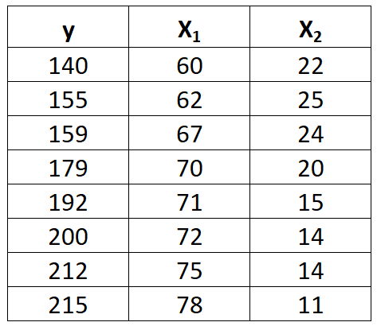
Multiple Linear Regression
Multiple Linear Regression:
Multiple linear regression is a method we can use to quantify the relationship between two or more independent variables and a dependent variable.
Suppose we have the following dataset with one dependent variable y (Point) and two independent variables X1(Age) and X2(Salary in k):
Exercise:
If Age X1=65, Salary X2=23k, So Point y=?

Slide 4
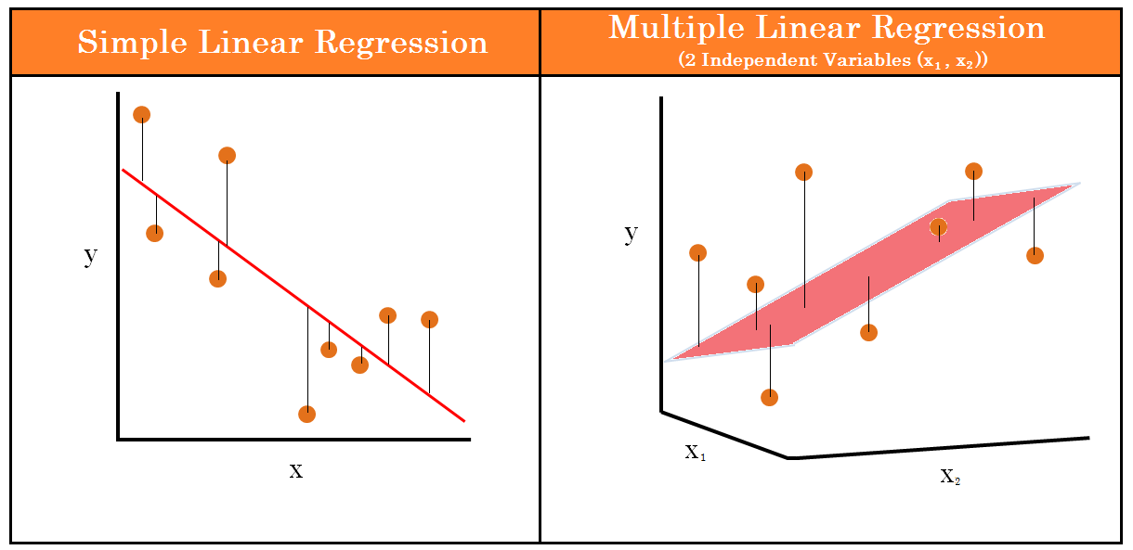
Multiple Linear Regression

Slide 5
Multiple Linear Regression
The formula for a multiple linear
regression line is
The formula for a simple linear regression line is
Y' = bx + a
y= b1*x1 + b2*x2...........+a

Slide 6
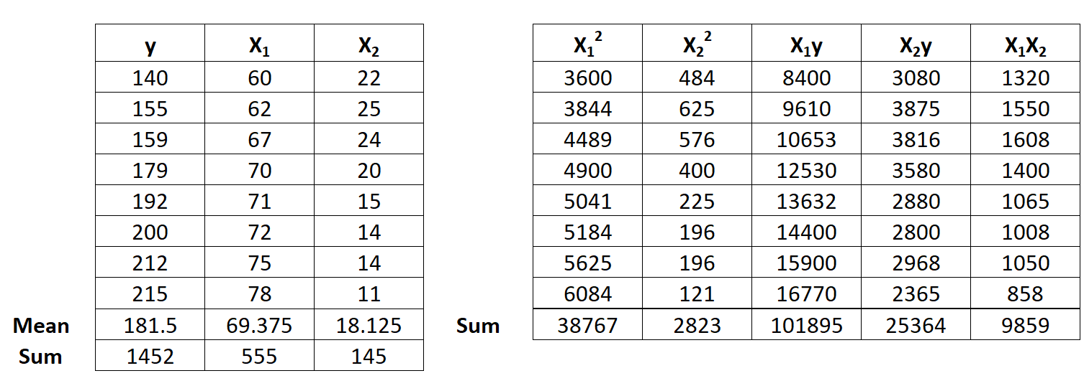
Multiple Linear Regression
Step 1: Calculate X₁², X₂², X₁y, X₂y and X₁X₂.

Slide 7
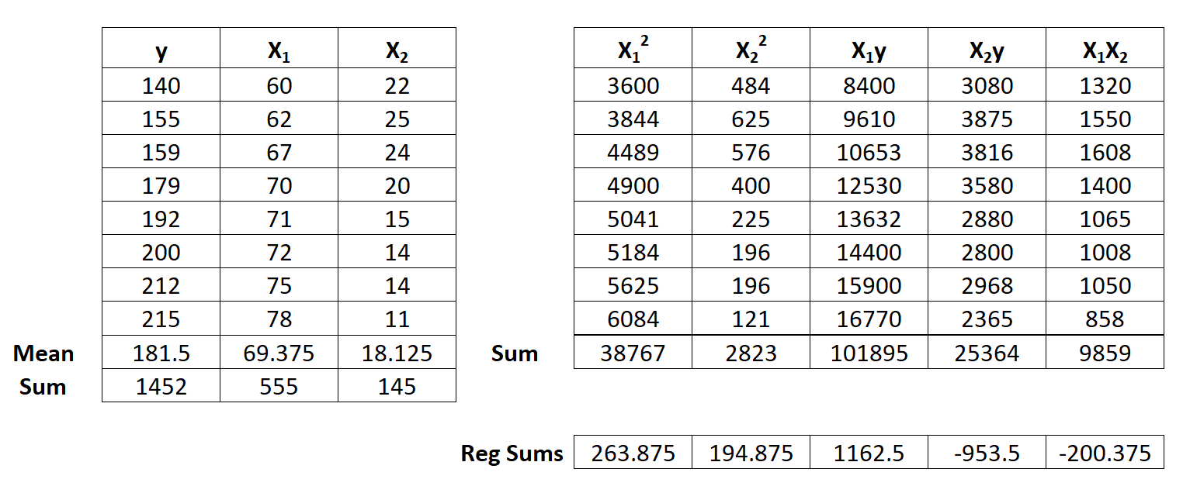
Multiple Linear Regression
Step 2: Calculate Regression Sums.
Σx₁² = ΣX₁² – (ΣX₁)² / n = 38,767 – (555)² / 8 = 263.875
Σx₂² = ΣX₂² – (ΣX₂)² / n = 2,823 – (145)² / 8 = 194.875
Σx₁y = ΣX₁y – (ΣX₁Σy) / n = 101,895 – (555*1,452) / 8 = 1,162.5
Σx₂y = ΣX₂y – (ΣX₂Σy) / n = 25,364 – (145*1,452) / 8 = -953.5
Σx₁x₂ = ΣX₁X₂ – (ΣX₁ΣX₂) / n = 9,859 – (555*145) / 8 = -200.375

Slide 8
Multiple Linear Regression
Step 3: Calculate a, b₁, and b₂.
The formula to calculate b1 is: [(Σx22)(Σx1y) – (Σx1x2)(Σx2y)] / [(Σx12) (Σx22) – (Σx1x2)2]
Thus, b1 = [(194.875)(1162.5) – (-200.375)(-953.5)] / [(263.875) (194.875) – (-200.375)2] = 3.148
The formula to calculate b2 is: [(Σx12)(Σx2y) – (Σx1x2)(Σx1y)] / [(Σx12) (Σx22) – (Σx1x2)2]
Thus, b₂ = [(263.875)(-953.5) – (-200.375)(1152.5)] / [(263.875) (194.875) – (-200.375)²] = -1.656
The formula to calculate a is: y – b₁ X₁ – b₂ X₂
Thus, a = 181.5 – 3.148(69.375) – (-1.656)(18.125) = -6.867

Slide 9
Multiple Linear Regression
Step 5: Place a, b₁, and b₂ in the estimated linear regression equation.
The estimated linear regression equation is:
y = b₁*x₁ + b₂*x₂ + a
In our example, it is y = 3.148x₁ – 1.656x₂ +(-6.867)
If Age X1=65, Salary X2=23k, So Point y=?
y = 3.148 * 65 – 1.656 * 23 - 6.867
= 204.62 – 38.088 – 6.867
= 160

